Slide 1
SFT 2275
Applying for Unemployment
October 22, 2020

Slide 2
SFT 2275 are not Employment Law Experts
What follows is not to be taken as legal advice about unemployment law
SFT 2275 and its officers are not experts in this field nor do they claim to be
What follows is a presentation of what we were able to learn from speaking with our colleagues in CWA as well as the SFT 2275 members who have been through this process

Slide 3
Four Phases to Presentation
Phase One: Background to Furloughs
Phase Two: Setting Up Your Account
Phase Three: Actually Applying
Phase Four: Certifying for your Weekly Benefits

Slide 4
Phase One: Some Background Context

Slide 5
Unemployment and Furloughs:
A little bit of history
This is not the first time workers have been furloughed in New Jersey
The most recent instance before this was in 2009, at the time of the “great recession”
That MOA, unlike this one, allowed members to select all of their furlough days, so long as faculty did not select days when they were scheduled to teach or professional staff picked days when they were required to do essential work
One of the furloughed individuals grouped all of his days together into a full week and then applied for unemployment for that time period.
The state ruled against him saying that, since he was able to choose, he could have spread them out over the year and thereby avoided being unemployed for that week

Slide 6
Differences with the 2020 MOA on furloughs
In order to allow Union members to apply for unemployment and thereby diminish some of the impact of the income loss this MOA was structured differently
In this MOA management may assign up to twelve furlough days to members of SFT 2275.
Note that they are not required to do so, they have discretion as to whether to assign the full twelve and may choose not to assign the full number
In some cases they have assigned fewer than the full twelve in order to achieve equity for those members, e.g., those professional staff who would otherwise not have been able to collect the extra $600 that was available up until late July 2020

Slide 7
What is the same?
As was the case back in 2009, we negotiated the agreement to forestall layoffs of our membership
It was based on and structured in line with the Master Agreement
Furlough days could not be taken on days faculty were scheduled to teach
Professional staff had to enter a different “code” for their furlough days with HR, while faculty, who don’t fill out timesheets, had that information done by an individual within the school known as a “super user”

Slide 8
Differences with the 2009 Furlough deal (cont.)
In this MOA the Friday after Thanksgiving is a mandated furlough day
Each member should select one furlough day for whenever they want (so long as it does not occur on a teaching day in the case of a faculty member)
The remaining ten days are to be issued in blocks of five each. For most of you (though not necessarily all)
The first five block set should have been sent to each member by Human Resources
The second five block set set will be in Spring Break

Slide 9
Unemployment is Possible for You For Those Blocks
Because:
You will be unemployed for five full days (as opposed to one or two days at a time)
Management is dictating the amount of time you are unemployed
You are willing to work, that is, i.e., it was not your choice to stop working
You are available to work, you didn’t do anything to make yourself unavailable
You meet the “earnings requirement
You work in New Jersey (notice it doesn’t matter where you live)

Slide 10
How much can you recieve?
This depends upon the amount you make and the number of dependents
Our information as of this presentation is that the weekly benefit is 60% of your average weekly wage, with a maximum of $598.
This benefit is increased if you have children:
by 7% for the first dependent of the claimant
4% for the next two dependents
for a maximum of three dependents.

Slide 11
Phase Two: Setting Up an Account

Slide 12
Create an Account Ahead of Time
You will not be able to apply for unemployment this semester
However, you can (and should) create an account without actually applying for unemployment benefits.
You will not be able to actually apply for benefits until the first day of your five day furlough but you can have the account already set up and ready to go.
Be ready with all of the following. The system is an antiquated one and does not let you “log out” and have your loaded up information saved. You need to be prepared to do this all in one sitting

Slide 13
Creating an Account (cont.)
You’ll need to go to their online system and enter your email address. Your email address must not contain more than 35 characters. Make sure you use an email address that you check regularly. This is the one that they’ll use to send you important information about your claim.
After you hit "SEND," they will send you a link to verify your email address. This link is only active for 60 minutes. The email will be sent from ui‐noreply@dol.nj.gov. You may want to add that email address to your "safe senders" list to make sure it doesn't get flagged as junk email.
Click the link in the email they send to complete the initial registration process. Remember, the link will expire after 60 minutes. If you do not complete the registration process within 60 minutes, you will need to re-enter your email address and have a new link sent.

Slide 14
Creating an Account: Your Personal Info
You may encounter page errors if you let your browser autofill the text fields.
Enter all the information manually.
first and last name
date of birth (formatted as MM/DD/YYYY, e.g. 04/07/1978)
Social Security number (without dashes)
phone number (numerals only)
email address (the same one you used to register)

Slide 15
Create a Password
You'll also need to create a password. Be sure to remember it and do not share it with anyone. Your password must contain at least the following:
eight characters
one number
one uppercase letter
one lowercase letter
one of these special characters:
! @ # $ % &

Slide 16
Phase Three: Actually Applying for Unemployment

Slide 17
Actually Applying
As we said earlier, you cannot actually send in your application for unemployment benefits until the first day of your five day furlough. For example, for me it will be Monday January 4, 2021
Again, as with creating an account, you have to be prepared to do all of this in one sitting.
It will not save it if you log off and if you let it be idle for 30 minutes or more.
Set aside at least fifty minutes for this

Slide 18
Information to have handy
Bank account number and Routing Number (if you plan to receive benefits through direct deposit)
Social Security Number.
Employer of last 18 months: Type in Richard Stockton State College, it will have a New Hampshire address.
IMPORTANT: Don’t correct this to “Stockton University” or try to make it a New Jersey address.
Recall date NJ State Exec Branch you will answer “no definite recall date”

Slide 19
Information to have handy (cont.)
It will ask for “Union hiring hall information, including local number and address—”
You will put AFT and your local number #2275
We’re not a “Union Hiring Hall”
The University mailing address of the Union:
SFT 2275
P.O. Box 785 Pomona NJ 08240

Slide 20
Information to have handy, possibly
• Alien Registration Number (if you are not a US citizen).
• Pension information (if you are receiving any pension or 401k).
• Amount and duration of any separation pay you may be receiving.
Let me say a little bit about these three

Slide 21
Note on Visa Holders
H-1B holders are exempt from the furlough requirements. This is spelled out in paragraph 1 of the Furlough MOA,
BUT
Other visa holders who are not subject to the Labor Condition Application may be furloughed
Please check out the following for further information:
http://www.cnjscl.org/Library/H-1B%20Visa%20ADDENDUM%20TO%20JUNE%2030%202020%20MOA-Signed.pdf

Slide 22
Pension Information
Question: Are you receiving, or have you applied for a pension or other retirement pay from any of the employers listed below?
Answer: If you are currently paying into a pension or other retirement plan but you are not receiving payments, you should answer “NO."
If you are receiving pension payments from an employer who is not listed you should also answer “NO."
You should answer “YES” if you are currently receiving pension or other retirement benefit payments from one of the employers in the list.
It may ask for the gross amount of distribution received and so you should have it handy

Slide 23
Separation Pay
You are not receiving separation pay from Stockton
However,
If you are also working for some other employer AND that employer is providing you with separation pay then you’d need to be prepared to put that information down

Slide 24
Worked somewhere else in the past 18 months?
Form SF-8 or SF-50 (if you were a federal employee).
Military Form DD-214 (if you were in the military in the last 18 months)
Other employer, not military? You’ll need:
Complete name and address of employer
Employer's telephone number
Your occupation with that employer
Beginning and ending dates of employment
Reason for separation

Slide 25
When you’ve got all that prepped
Go to myunemployment.nj.gov to Start Your Claim
If you’ve already created an account then click on “Existing Users log in here”
If you still have yet to create an account then do so (see previous instructions for creating an account)

Slide 26
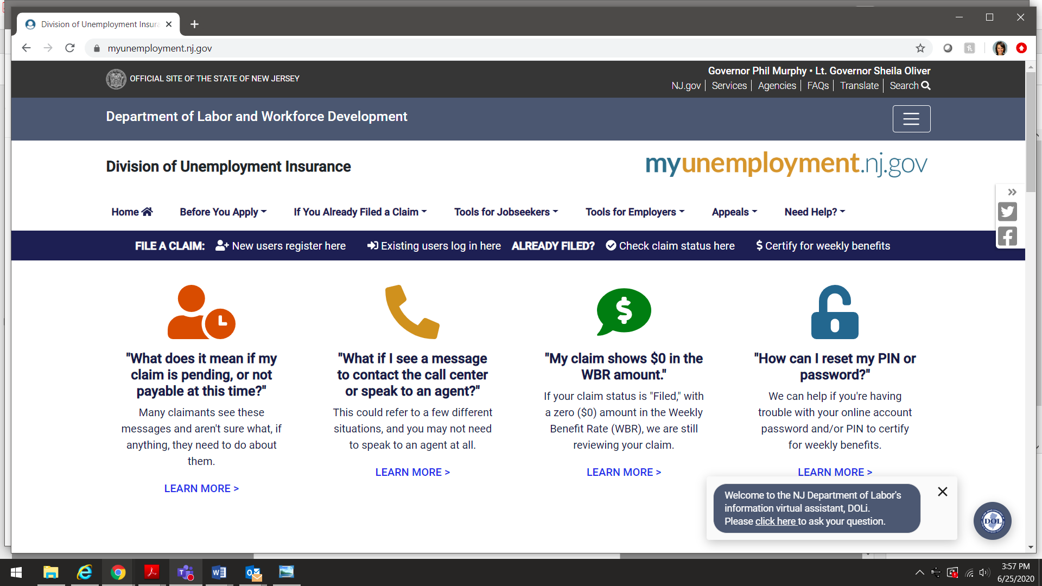

Slide 27
Answering their questions: general information
Question: Were you able and available for work?
If you are out of work temporarily due to an employer-closure related to the coronavirus and expect to return to your job, select “Yes”.
Answer: Select “Yes

Slide 28
Answering their questions: general information (cont.)
Question: When you worked in New Jersey, did you live out of state?
If you live out of state and work in New Jersey,
Answer: select “Yes”.
“If ‘Yes’ will you continue seeking work in NJ?””
Answer: Select “Yes”

Slide 29
Eligibility Information
Question Were you able and available for work?
If you are out of work temporarily due to an employer-closure related to the coronavirus and expect to return to your job, select “Yes”.
Answer: Select “Yes”
Question: Are you ready, willing and able to immediately work full-time?
Answer: “Yes”.

Slide 30
Eligibility Information (cont.)
Question Do you wish to have 10% Federal Income Tax withheld from your benefits?
Answer: Yes or No. Carefully consider your choice. Keep in mind that if you don’t, you’ll have to pay it later
Question Do you wish to claim a dependency allowance?
Answer Yes or No. (If you are also married to a state worker who is furloughed, only one of you can claim this additional allowance.)

Slide 31
Eligibility Information (cont.)
Question Are you a member of a union?
Answer: Yes. (All AFT-covered state employees should answer “yes.”)
If Yes, do you seek work through a Union hiring hall?
Answer: No.
Question How do you wish to receive your benefits?
Answer: Direct Deposit or Debit Card.
(Direct Deposit will enable you to enter your account information.
Debit cards will be mailed to you within a week of application.)

Slide 32
Employment Information
State Employer Payroll Number
Answer leave it blank and we believe it will automatically populate from our on-file employment information.
Are you still employed by this employer?
Answer “Yes”
If “Yes”, explain the reason why you are filing unemployment
Select “Reduction in Hours by Employer”

Slide 33
Employment Information (cont.)
Question: Please select your reason for separation from this employer
Answer Select “Other – COVID-19 related” business closed/hours reduced COVID-19 related
Question: Do you expect to be recalled by this employer?
Answer “Yes”.
Question: Do you have a definite date of recall?
Answer “No”
Question: What was the last day you worked for this employer?
Answer Enter the last day you actually worked before your first day of furlough. Put down the Friday before the furlough begins. It’s your last paid day.

Slide 34
Employment Details
Question: If you received or will receive holiday pay, payment in lieu of notice, vacation pay, severance pay, continuation pay, or other pay for any period after your last day of work,
Answer: You should not have this because we have to take 5 consecutive days.

Slide 35
Phase Four: Weekly Certification

Slide 36
Timing
Unemployment Insurance weeks begin on a Sunday and end at midnight on Saturday.
Your claim is dated the Sunday of the week in which you filed your initial (first) claim. So, for example my “claim period” will be Jan 3-Jan-10.
In order to actually receive the money you need to go in again and certify your claim which can only be done on their schedule. They post this schedule on Saturday night.
Your time to be able to certify your claim is based on the last four digits of your Social Security Number.

Slide 37
Timing (cont.)
To receive your unemployment insurance benefit payments, you must go online and certify for benefits for each week which you wish to receive benefits.
Only after the workweek has passed (after Saturday at midnight) are you able to certify for benefits for that workweek.
This link gives you a list of questions and answers you’ll need to give about your covid furlough.
https://myunemployment.nj.gov/labor/myunemployment/covidinstructions.shtml

Slide 38
Earnings Information
It will ask you for your
SSN,
PIN,
Earnings for the week you are claiming.
Answer: You’re not getting any pay during that week.
IF they ask for your “hourly rate”
we are paid for seventy hours in a regular pay period, so
if you took bi-weekly gross, (base salary) AND
Divide that number by seventy you should get your hourly rate.

Slide 39
Timing (cont.)
How long will it be between when I apply and when I will be able to certify for benefits?
Answer: Your claim is dated the Sunday of the week in which you filed your initial (first) claim.
How do you know when to certify?
Answer: You will receive instructions in the mail after the claim is filed. If you filed online, you should (though you can check the status in your account online if you don’t get it) receive an email once your claim has been entered.
If your claim is determined eligible for benefits, you will be able to certify online during the next block of time assigned to your Social Security number.

Slide 40
Timing (Cont.)
How do I find the day and time when I can certify?
Answer: Check the schedule. The schedule is subject to change weekly so make sure to check regularly to be aware of when you can claim your benefits.
See when your Social Security number is scheduled to certify for benefits for the current week:
https://myunemployment.nj.gov/labor/myunemployment/schedule.shtml.
When it is your time to certify, log-in to the online application and answer the required questions. You will have 30 minutes, but it’s very quick
There are “catch up” dates if you happen to miss your time, but it’s all based on the last four digits of your SSN

Slide 41
Q & A Section
The following are some questions that were sent to us in the Q&A section of the webinar or the “Chat” area
We have done our best to answer them but there may be one or two we still need to learn

Slide 42
Claiming dependents and W-4
Can you claim a dependent even if no dependent was claimed on W-4? Who is a dependent? And can you explain the dependency benefits?
Yes, you can.
Additionally, a dependent “is defined as an unemployed spouse/civil union partner or an unemployed, unmarried child (including stepchild or legally adopted child) under the age of 19 (or 22 if the child is attending school full-time).”
And from the website: “Dependency Benefits are equal to 7 percent of your weekly benefit rate for the first dependent, and 4 percent for each of the next two dependents. The maximum amount of Dependency Benefits you can collect is 15 percent of your weekly benefit rate for three dependents. Dependency Benefits will only increase your weekly benefit rate up to the maximum weekly benefit rate, as no claimant can receive more than the maximum weekly benefit rate.”
Additional details about the “Dependency benefits” are located here: https://myunemployment.nj.gov/labor/myunemployment/before/about/howtoapply/dependencybenefits.shtml

Slide 43
10 or 12 Month Salary?
Is weekly wage based on 10 months or 12 months?
Technically, for faculty it’s based on 10 months; however, if you’re someone who spreads out your paychecks over 12 months, you will need to look at the amount of pay that is deferred (it appears directly on your paystub) each week to add to that particular week.
Again, we believe the software should populate the wages part of your application without you having to calculate all this. We will continue to investigate

Slide 44
My single day choice
One of my single days is the week following a 5-day furlough period. Can I include that in my request?
Typically the answer is no, especially if the single day is one you selected. Only days issued to you by the University are eligible for unemployment. The unemployment week runs Sunday-Saturday and you cannot claim a single day.

Slide 45
Create an account now or later?
Should we create the account first, or can we wait until we are ready to submit the application?
You can do either, but you absolutely can create the account now.

Slide 46
I’m getting a pension from another job I retired from
I get a pension from another location, do I need to put that in?
If you are receiving a pension from anywhere, yes you would need to put that down.

Slide 47
When do I get my money?
How long does it usually take from the day you apply to the day you get the money?
It typically takes about 2 days from the day you recertify to the day you receive the money through direct deposit.
However, we have also heard from AFT colleagues at our sister institutions of it taking longer AND
if there mistakes in filling something out, that can also cause a delay.
We recommend budgeting for that week very carefully

Slide 48
How often do I certify?
Do we need to reapply each of the two weeks?
Yes, you will need to apply for and certify for each separate week; however, you only need to create the account once.

Slide 49
When do I Certify?
When do you certify? If furlough begins Monday, does certification commence the following Saturday?
You will certify after the furlough week ends; the schedule to certify will be posted the Saturday of the week you are furloughed and your time period for when you can log on and do this is determined by your Social Security number.

Slide 50
How does Social Security Factor Into This?
What if you are collecting Social Security benefits? Do you have to note these in the application process?
From the unemployment site: “Social Security retirement benefits do not affect your Unemployment Insurance benefits.”

Slide 51
What about Overload pay?
It is my understanding that since the furlough is based on base salary, and we will continue to get OverLoad pay if the furlough during the spring semester, we will not be eligible for unemployment since we will be getting some salary?
You are still eligible for unemployment. You should work with your AD or School Super User to ensure that your OL is paid in a different pay period.

