Slide 1
SFT: Disabilities in the Classrooms
Lydia Fecteau AND Priti Haria,
August 24, 2017
Acknowledgement: Bob Ross from Learning ACCESS program
Notes:
Stockton Statistics
Discuss about ADA/504– college compliance (IDEA and ADA)
Syllabus Statement
Examples of “Invisible Disability (Optional)
General Characteristics
UDL
Multiple Intelligence
Accommodations (Tool Box, etc.)
Disability Culture
Disability Studies Minor

Slide 2
LAP YEARLY REGISTERED # OF STUDENTS
ACADEMIC YEAR | REGISTERED LAP STUDENTS
2014-2015 | 704
2013-2014 | 504
2012-2013 | 484
2011-2012 | 475
2010-2011 | 424
2009-2010 | 344
2008-2009 | 293
The Learning Access Program: http://intraweb.stockton.edu/eyos/page.cfm?siteID=286&pageID=5

Slide 3
Accommodations Report
ACCOMMODATION | 2013-2014 | 2014-2015
Extended test time | 216 | 316
Testing in distraction reduced environment | 141 | 179
Note-taker | 97 | 105
Symptoms Associated with Disability – extended due dates/rescheduling exams |  | 88
Allow student to briefly leave class | 74 | 71
Attendance | 52 | 69
Important instructions in written form | 55 | 66
Use of AUDIO recorder | 40 | 62
Books on tape | 24 | 29

Slide 4
Definitions of Disability
The World Health Organization defines disability as an umbrella term that encompasses impairments, activity limitations and participation restrictions that reflect the complex interaction between “features of a person’s body and features of the society in which he or she lives. (Garland-Thomson 2016)” The Americans With Disabilities Act tells us that disability is “a physical or mental impairment that substantially limits one or more major life activities, a history of having such an impairment, or being regarded as having such an impairment.” (bold mine)

Slide 5
Examples of “Invisible Disabilities”
Invisible disabilities are the most common type of disability among college students. They are:
Learning Disabilities
Attention Deficit/Hyperactivity Disorder (ADHD)
Asperger’s/High-Functioning Autism
Some forms of Epilepsy
Mental Health Conditions (i.e., Anxiety, Reactive Attachment Disorder)
Dyslexia/Dysgraphia
Gifted students with additional exceptionalities
Sensory Processing/Integration Disorders
Auditory and Visual Processing Disorders
Anxiety, OCD, etc.
Notes:
Disability is simply one of the many things about the student. All students have strengths and talents and different way of perceiving, processing and expressing information. Focus is to level playing field by providing accommodations.

Slide 6
Disability Law in Higher Education
The Americans with Disabilities Act of 1990 and Section 504 of the Rehabilitation Act of 1973
Requires the University to make reasonable accommodations for those otherwise qualified individuals with a disability who request accommodations
Reasonable academic accommodation is a modification or adjustment that allows an individual to gain equal access and have equal opportunity to participate in the University’s courses, services, activities and use of facilities
The University is not obligated to provide an accommodation that requires a substantial change in in the curriculum or alteration of any essential elements or functions of a program
Notes:
What is a Reasonable Accommodation:
Determining reasonable accommodations is an interactive process. The following questions need to be asked and answered to identify the reasonable accommodations.
Is the individual a "person with a disability"?
Is the individual "otherwise qualified"?
What are the barriers resulting from the interaction between the documented disability and the campus environment?
What are possible accommodations, modifications, or adjustments that might remove the barriers?
Without these accommodations, would the individual still have meaningful access to the program, service, or activity?
Would these accommodations compromise the essential elements of the curriculum?
Would these accommodations require a fundamental alteration in the nature of the program, service, or activity?

Slide 7
Syllabus Accessibility Statement http://intraweb.stockton.edu/eyos/page.cfm?siteID=286&pageID=13
In accordance with the Americans with Disabilities Act of 1990 as amended and Sections 504 and 508 of the Rehabilitation Act, students with a documented disability and need accommodations, are encouraged to register with the Learning Access Program (LAP). Registration for support services is strictly voluntary and on a confidential basis. Support services provided by LAP are meant to help students devise strategies for meeting the University’s educational demands and to foster independence, responsibility, and self-advocacy. The Learning Access Program can be found on campus in room J-204 or online at www.stockton.edu/LAP. Please call 609-652-4988 or send an email to LAP@stockton.edu for more information. Once you have received an accommodation letter from LAP, please contact your instructor to privately discuss your needs as soon as practical to ensure that reasonable accommodations are implemented.
Notes:
http://www.disabilitydirectresponse.com/compliance-library/67
Postsecondary institutions must engage in a dialog with students seeking accommodations to ensure that they are not denied necessary academic adjustments, auxiliary aids and services. The purpose of the interactive process has been defined by the OCR as being “to determine whether requested modifications, or other effective accommodations should be provided and would enable the student to meet college standards without modifying essential requirements.” (College of Marin, 35 NDLR 177 (June 2006)).

Slide 8
Self-Advocacy

Slide 9
Self Advocacy Leads to Autonomy

Slide 10
ADA/Section 504 Compliance
Architectural Barriers
Instructional Support
Educational Accommodations
Technological Adaptions
Language Awareness
Notes:
High school provides accommodation and t
Students feel lost in college as they are not given supports as they were in schools.

Slide 11
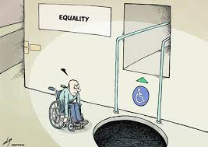
Architectural Barriers
Automatic doors
Any door over 5 pounds
Not working
Bathrooms
Ramps
Signage
Captioning
Parking
Blocked
Van accessible
If you see an issue, email a note to: Access@stockton.edu

Slide 12
General Characteristics
Cognitive (Attention, Memory, Organization, etc.)
Social & Emotional
(fears, Anger, withdrawn, Anxiety, aggression, Low self-esteem, Depression)
Physical (Lighting, Furniture Arrangement, etc.)
Academic
(Reading, Writing, Math, etc.)
Classroom Climate & Environment (Structured, Safe, Restrictive, Unstructured, etc.)
Notes:
How to incorporate disability culture in their classroom?

Slide 13
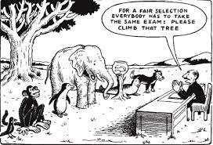
Reasonable Accommodations
The goal is to engage students with different learning styles and abilities.
Students need to learn self advocacy and how to express their accommodation needs.
Notes:
(How to Support Students? Or What does it mean to support students in your classroom? )

Slide 14
What is & What is Not “Reasonable Accommodation?”
What is “Reasonable Accommodation?”
What is NOT “Reasonable Accommodation?”
Extended test time
Allowing as assistant or interpreter in the class
Quiet, separate test location
Note takers
Texts and class materials in alternate formats
Accessible desks
Interpreters
Microphones and recording devices
Students should know their rights
Shortened test
Personal assistant
Smaller assignments
More time off
Graded on different scale
Grade changes
Substantial change to essential element of the curriculum

Slide 15
How to Access Education and Curriculum?

Slide 16
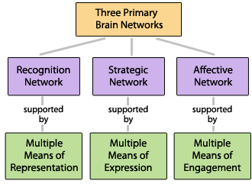
Universal Design for Learning (UDL) Higher Education Opportunity Act of 2008
The term UDL means a scientifically valid framework for guiding educational practice that:
Provides flexibility in the ways students are engaged (engagement), information is presented (recognition), and in the ways students respond or demonstrate knowledge and skills (action and expression), and...

Slide 17
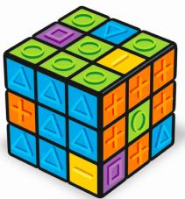
Universal Design for Learning (UDL)
The term UDL means a scientifically valid framework for guiding educational practice that:
reduces barriers in instruction and learning,
provides appropriate accommodations, supports, and challenges, and
maintains high achievement expectations for all learners

Slide 18
Howard Garner’s Multiple Intelligence
Multiple Ways to Present Materials
video tape
audio tape
computer
readers
Interpreters
Braille, etc.
Content Enhancements
Chapter Outlines
Narrated Power Point
advance organizers
visual displays
study guides
mnemonic devices
peer mediated instruction
computer assisted instruction
Multiple Ways to Respond
oral response or written response
Create Posters; Debate; Projects, etc.
Use of notecards and post it for responses
Technology (Polls Everywhere; Apps; etc.)
computer/word processing

Slide 19
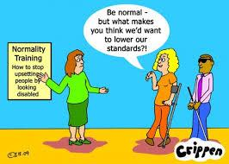
Educational Accommodations
Learning Access Center Letter for Accommodation
Picture Captioning
Closed Caption
Documents JAWS readable
Mics to amplify voice
The Wellness Center

Slide 20
Technology Tool Box
Audio and E-books
Blackboard
Whiteboard
See the "Evaluating Publisher Content for Accessibility" page
Stockton's Accessibility Tools

Slide 21
Technology Tool box
The Learning Access Program has a list of programs and applications that may help instructors and students. These include:
Read & Write Gold- a program that makes the web, documents, and files more accessible through an intuitive and user friendly toolbar that assists students, faculty, and staff with everyday tasks such as reading text out loud, understanding unfamiliar words, researching assignments and proofing written work.
Kurzweil- provides built-in features for reading, writing and study skills for those students struggling with literacy.
JAWS- is a screen reader, which was developed for computer users whose vision loss prevents them from seeing screen content or navigating with a mouse.
Dragon Naturally Speaking is a voice-driven program that allows students to create, format and edit documents by thinking out loud. This program is designed to help students increase productivity, creativity, and multi-tasking.
Smart pens work like a pen, but use Bluetooth technology to record audio and send it to a smartphone, tablet, or PC. This product is designed to help students capture the most from classroom lectures and documents information that could be missed while in the classroom.

Slide 22
Technology Tool Box
Screencast-o-matic: is a video recording tool.
Screencast-o-matic: https://screencast-o-matic.com/home
Edpuzzle: easiest way to engage students with video
Edpuzzle: https://edpuzzle.com/
Edpuzzle Tutorial: https://www.youtube.com/watch?v=AV66e9z-fr8
Padlet: is an app used as an electronic writing pad to post comments:
Padlet: https://padlet.com/
Blackboard: is a learning managing system.
Blackboard: https://blackboard.stockton.edu/ ;
Blackboard Collaborate Video Conferencing Tool: https://elearning.stockton.edu/student-support/collaborate/
Educreations: https://www.educreations.com/

Slide 23
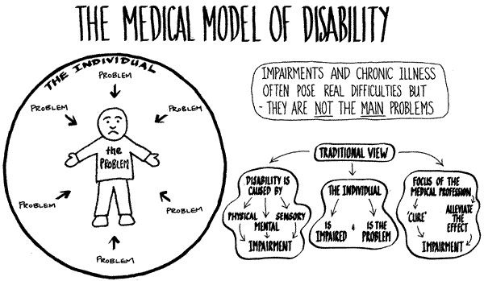
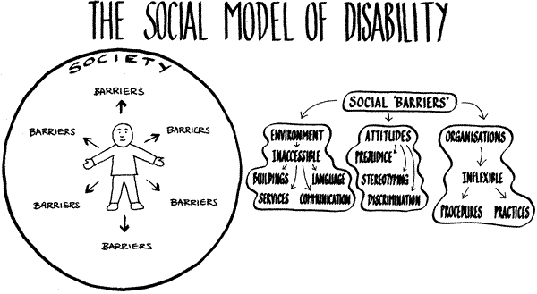
Change of Framework: Disability Culture
From Medical Model of Disability (Cure, Fix or Separate) →
To Social Model of Disability based on Human Rights Approach; Problem with Society that needs to be changed:
Attitudes
Organisation
Environments
Notes:
PWD are ill, invalid
Treatment is recovery and protection
The PWD need to be segregated
PWD are citizen with different abilities
PWD live discrimination & lack of equal opportunity
Treatment is social inclusion
All society is competent
Prevalent competences for PwD are medical

Slide 24
Incorporating Disability Culture in your Pedagogy
Understanding not pity, don’t fall for inspiration porn
Acceptance of human variation
Matter of fact orientation using assistance
tolerance for unpredictable and living with uncertainty
disability humor
People with disabilities have forged a group identity. They share common history of oppression and a common bond of resilience. They generate arts, music, literature, and other expressions of their lives in their culture, infused from their experience of disability. Most importantly, they're proud of themselves as people with disabilities. They claim their disabilities with pride as part of their identity.

Slide 25
Student First Language
http://www.youtube.com/watch?v=SbGdPXfrF4M&feature=player_embedded
Say
Person with disability
Billy with cognitive difficulties (Mental Retardation)
Children with Autism
Classroom for students with mental retardation
Students with visual impairment
Disability or disabled
Bus for students with disabilities
Boy with Cerebral Palsy
Girl with hearing impairment
Do Not Say
The disabled person
Mentally retarded Billy
The autistic children
The mentally retarded classroom
The blind student
Handicap or handicapped
Special education boy
The cerebral palsy boy
The deaf girl
The learning disabled girl
Notes:
Choice of language; How do we discuss about disability in our classrooms?

Slide 26
Disability Studies Minor Requirements
20 Credit Hours;
Receive C or Better in all the courses
introductory courses (1 Course):
GSS 1062: Disability & Dignity
GAH 2356: Disability Rights and History
GAH 2281: Intro to Disability Studies & Theory
Electives (3 Courses):
GAH 2336: Eugenics;
ANTH 2410: Stigma
HLTH 2210: Sign Language
EDUC 2241: Educating Children with Special Needs
Capstone (1 Course):
GIS 4605: Disability Advocacy and Policy
GIS 3686: Disability Studies Around the World
E-Portfolio
Check us Out at:
https://www.facebook.com/SUDSminor/
https://stockton.edu/general-studies/disability-studies-minor.html
Notes:
GAH 2356 Disability Rights and History that would focus on issues relevant to the social and health sciences, while GAH 2281: Introduction to Disability Studies and Theory would focus on issues relevant to the humanities. At the completion of the introductory courses, students can enroll in a choice of three pre-approved courses which are primarily, but not exclusively housed in General Studies. As students near completion of the minor, they will be required to complete a capstone course tentatively identified as GIS 4605: Disability Advocacy and Policy or GIS 3686: Disability Rights Around the World. These courses will use seminar style format and include service learning project and research paper which will provide an opportunity to students to integrate their major with the disabilities studies minor.

Slide 27
Questions & Contact Information
Lydia Fecteau: Lydia.fecteau@Stockton.edu
Priti Haria: Priti.haria@Stockton.edu

Slide 28
Learning Access Program LAP: https://www.stockton.edu/wellness-center/disability-services/index.html
Patty McConville, Coordinator of Services for Students with Disabilities for NAMS, BSNS, & HLTH
Bob Ross, Coordinator of Services for Students with Disabilities for ARHU, EDUC, SOBL, GENS & Undecided
Nancy McGarigal, Technical Assistant responsible for accommodated testing, note-taking and interpreting services.
Maria Spade, Adaptive Technology Specialist for all students registered with LAP

